Slide 1
FINDING YOUR INNER VCELL MODELER

Slide 2
The Virtual Cell Project
National Resource for Cell Analysis and Modeling
P41GM103313
Current Development Team
Leslie Loew
James Schaff
Boris Slepchenko
Ion Moraru
Ann Cowan
Michael Blinov
Masoud Nickaeen
Diana Resasco
Fei Gao
Susan Staurovsky
Frank Morgan
Stephen King
Dan Vasilescu

Slide 3
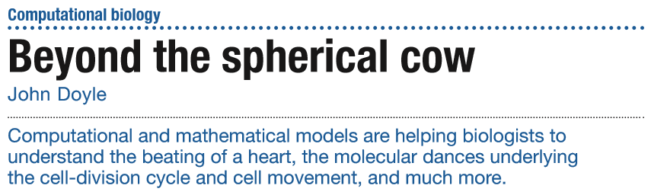
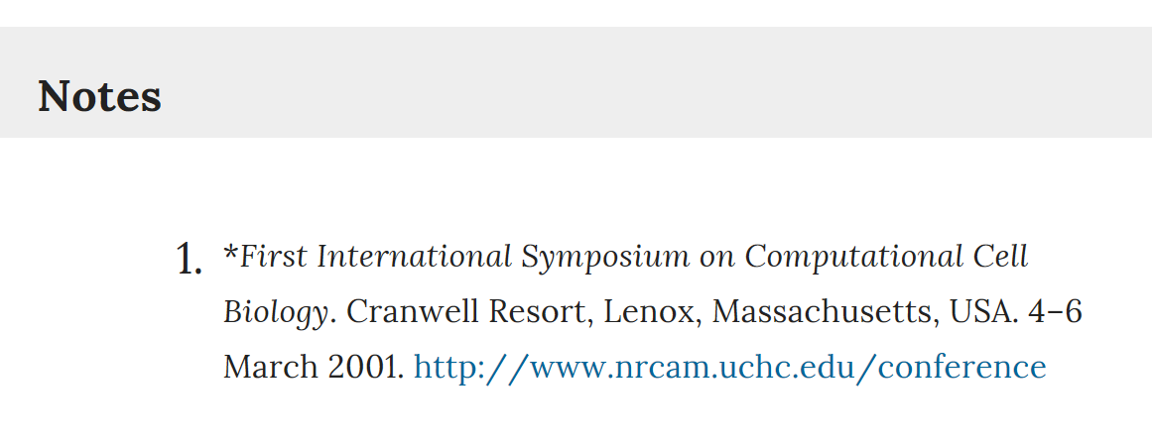

Slide 4
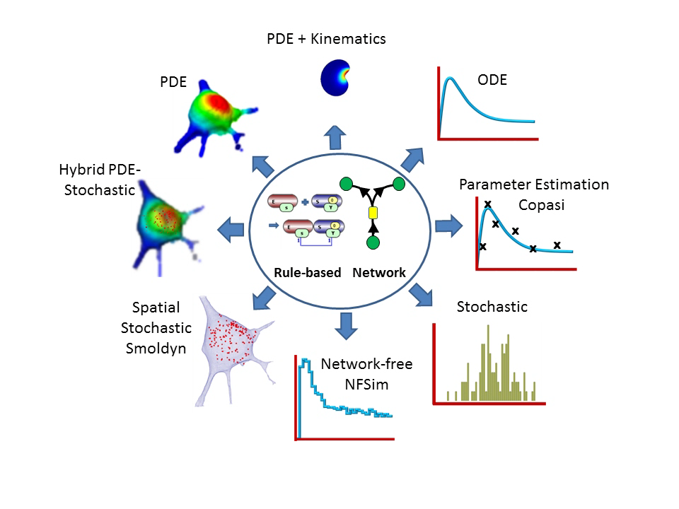
FINDING YOUR INNER VCELL MODELER

Slide 5
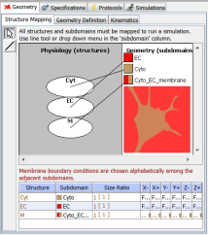
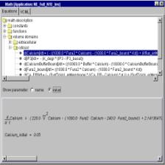
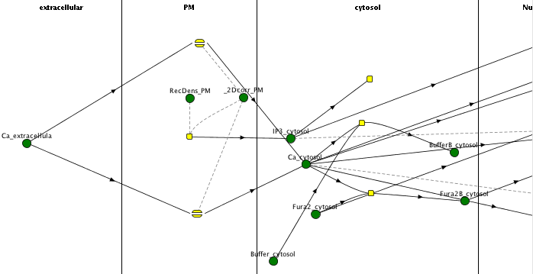
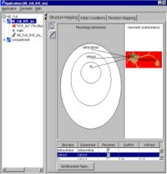
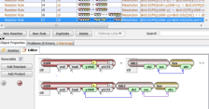



Physiology
(Biological Mechanisms)
Applications
(Physical Model)
Math Description
Applications
Math Description
Applications
Applications
Math Description
(Equation-based)
Reaction/Transport Network
Or
Mathematical Framework
Stochastic or Continuous?Spatial or Nonspatial?
Reaction Network or Agents?
Physical Approximations
Species are fields, particles, clamped, well-stirred
Fast Reaction System (PSSA)
Protocols:
Current/Voltage Clamp, Discontinuous Events, Simulated Microscopy
DIffusion, Advection, IC, BC
Topology Geometry,
Initial Conditions, Boundary Conditions, Diffusion Coefficients, Pseudo-steady, Enable/Disable Reactions
VCMDL
Topology Geometry,
Initial Conditions, Boundary Conditions, Diffusion Coefficients, Pseudo-steady, Enable/Disable Reactions
Topology Geometry,
Initial Conditions, Boundary Conditions, Diffusion Coefficients, Pseudo-steady, Enable/Disable Reactions
Simulations
Simulations
Simulations
Rule-based modeling (network free/agents
BioNetGen)
Timestep,
Mesh Size,
Parameter
Searches,
Sensitivity
Simulations
Timestep,
Mesh Size,
Parameter
Searches,
Sensitivity
Timestep,
Mesh Size,
Parameter
Searches,
Sensitivity
Timestep,
Mesh Size,
Parameter
Searches,
Sensitivity
Images
Results
k_{on}*(IP3_cyt)*(IP3R_mem)
-k_{off}(IP3Rbound_mem)
Images
Results
Results
Reaction Rate Expressions
Results
Notes:
The modeling process within the Virtual Cell BioModel workspace. Each component of the overall model is labeled over a screen snapshot of the corresponding section of the user interface. This hierarchical structure emphasizes a general physiology definition, the BioModel, that specifies the topology of the system, the identities and locations molecular species, and reactions and membrane transport kinetics. The BioModel can then have several Applications that each specify a specific geometry, boundary conditions, default initial concentrations and parameter values, and whether any of the reactions are sufficiently fast to permit a pseudo-steady state approximation. Also at the Application level, individual reactions can be disabled as an aid in determining the proper initial conditions for a prestimulus stable state. An Application of a BioModel is sufficient to completely describe the governing mathematics of the model and, as noted above, a VCMDL file is generated at this point. The Virtual Cell is designed to maintain a separation between this mathematical description, generated either via a BioModel or a MathModel, and the details of how the simulations are implemented. As shown in Figure 1, several simulations can be spawned off of a given Application. The simulation specifications include the choice of solver, time step, mesh size for spatial simulations, and overrides of the default initial conditions or parameter values. A local sensitivity analysis service is also available at the simulation level to aid in parameter estimation and to determine which features of the model are most critical in determining its overall behavior.

Slide 6
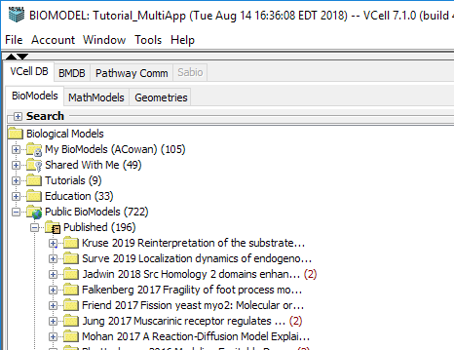
VCellDBase designed for community modeling

Slide 7
Examples of VCell models
Three vignettes of VCell modeling
Actin assembly in the lamellipodium
Analyzing dynamic fluorescence experiments
Signaling in kidney podocytes

Slide 8
Examples of VCell models
Actin assembly in the lamellipodium

Slide 9
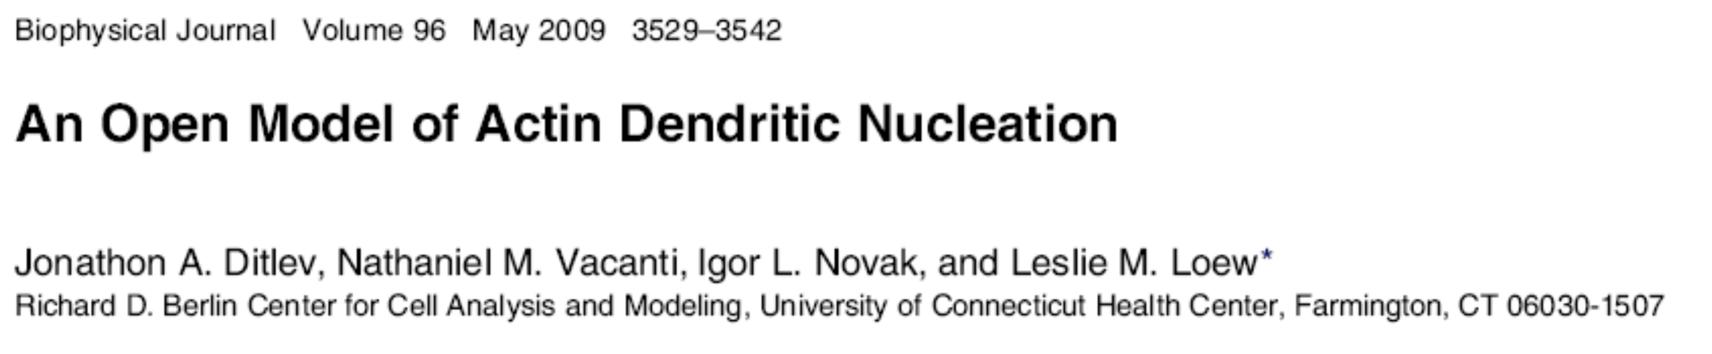
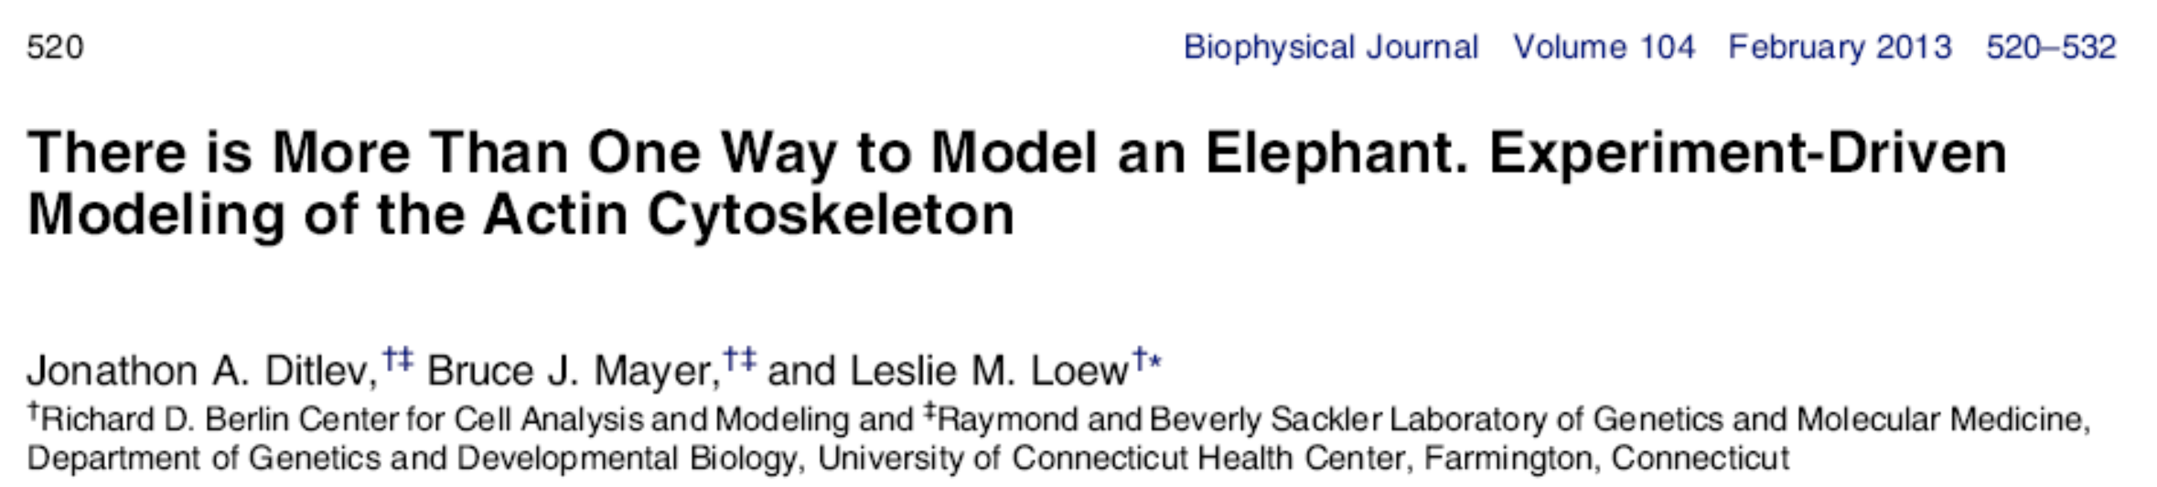
Modeling Actin Dynamics

Slide 10
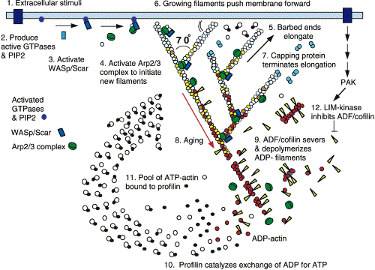
3 kinds of actin:
ATP, ADPPi, ADP
2 kinds of end:
barbed, pointed
13. Thymosin-ß4
buffers G-actin
14. Actin filaments anneal and fragment
Pollard & Borisy, 2003

Slide 11
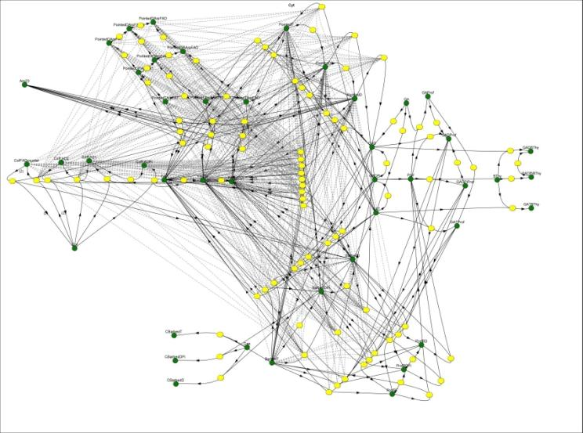
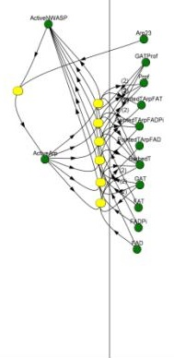
Reaction Network in Virtual Cell
At the Membrane
In the Cytosol
PM Cyt
Aging and
dissociation of
branches
Pointed end turnover
Profilin binding and
ADP/ATP Exchange
Cofilin cooperative
binding, severing and
enhanced Pi release
Annealing
and
fragmentation
Aging: ATP hydrolysis
followed by
Pi dissociation
Thymosin-ß4
buffering
Arp2/3 activation
and side branching
Barbed end turnover
with and without profilin
Barbed end
capping

Slide 12
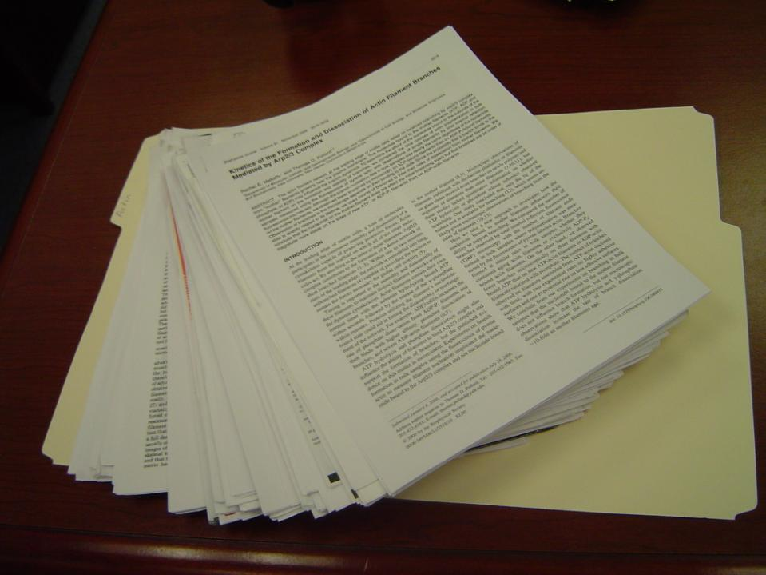

Slide 13
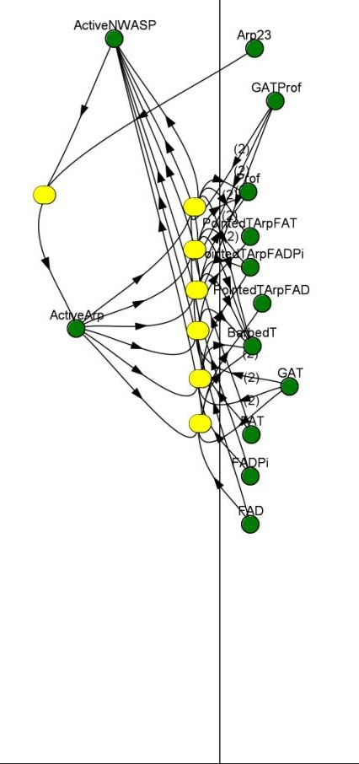
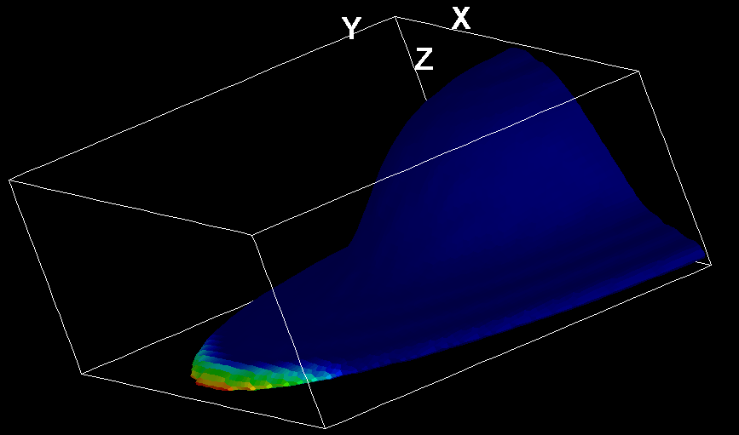

Activation at the
Edge of a Lamelipodium
560
molecule/µm²
Diffusion of GActin Species = 5µm²/s
Diffusion of FActin Species =
0
molecule/µm²
Membrane Cytosol

Slide 14
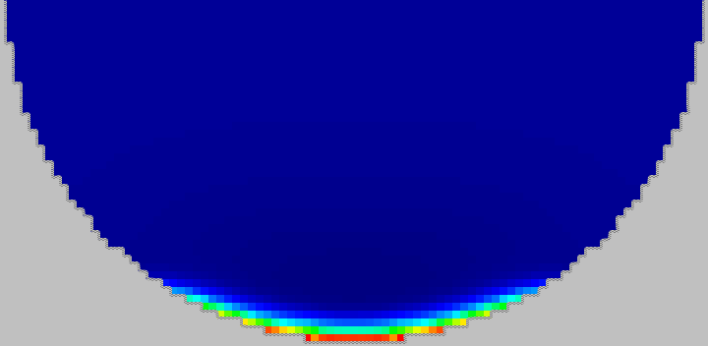
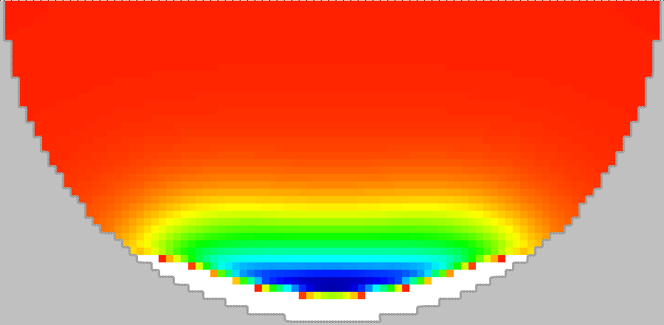


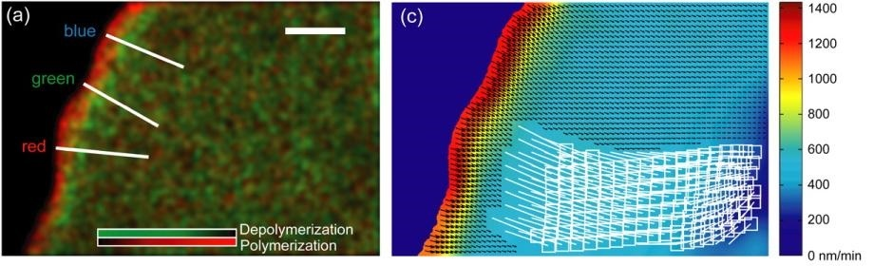
Actin Turnover
>0µM/s
18µM/s
0µM/s
5 µm
5 µm
-1.2µM/s
-1.2µM/s
Speckle Microscopy: Actin Velocity Field for an Epithelial Cell
A. Ponti, A. Matov, M. Adams, S. Gupton, C. M. Waterman-Storer and G. Danuser, Biophys. J., 2005

Slide 15
Does ADF/Cofilin Promote or Inhibit Actin Polymerization?
Sofya Borinskaya
Simulate increase in F-actin following activation of
NWASP → Arp2/3 for varying levels of
Cofilin and Capping protein (Prof = 20µM)
Notes:
15

Slide 16
Conclusions
Capping protein is required to maintain the GActin pool, but too much inhibits new filament assembly
Cofilin inhibits assembly at low [cap] and promotes assembly at high [cap]
The strikingly sharp boundary between filament assembly and disassembly that has been observed experimentally is an emergent property of the model
This model can serve as a basis for hypothesis generation and as a module for the response of actin to cell signaling

Slide 17

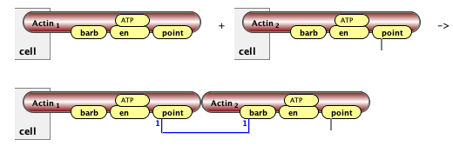
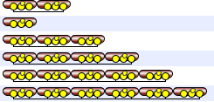
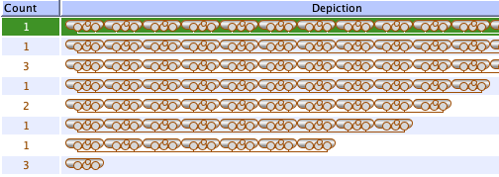
Rule-based modeling @VCell
Interacting molecules:
Rules of
interactions
BioNetGen Generated network
NFSim Simulated network
Seed species
generated species

Slide 18
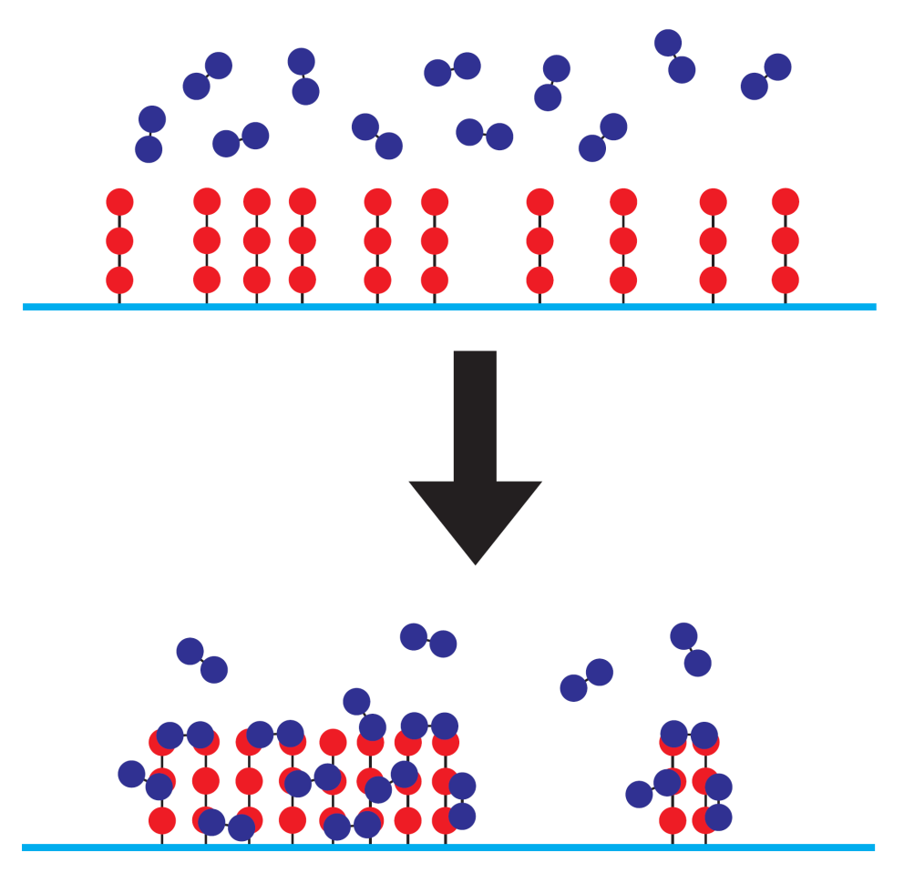
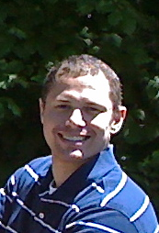
SpringSaLaD: Springs, Sites and Langevin Dynamics
Michalski, P. J., and L. M. Loew. Biophys. J.
2016. A Spatial, Particle-Based Biochemical Simulation Platform with Excluded Volume.
Advantages
No issue with combinatorial complexity.
Provides spatial and orientational information.
Excluded volume accounts for protein sizes and steric hindrance.
Captures exact dynamics, including reduced diffusion of larger clusters.
Disadvantages
1) Computationally expensive.
Paul Michalski

Slide 19
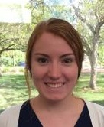

Modeling Nephrin-Nck-NWAsp clustering: Madeleine Youngstrom & Ani Chattaraj

Slide 20
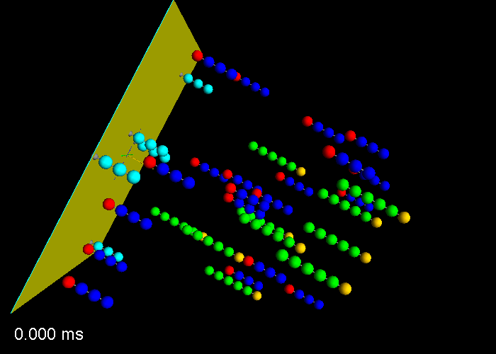


Slide 21
Examples of VCell models
Analyzing dynamic fluorescence experiments

Slide 22
Actin Binding Proteins in Dictyostelium
Green = α actinin Red = filamin

Slide 23


Actin Binding Proteins in Dictyostelium

Slide 24
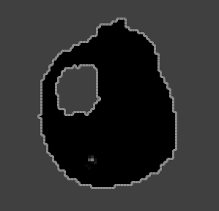
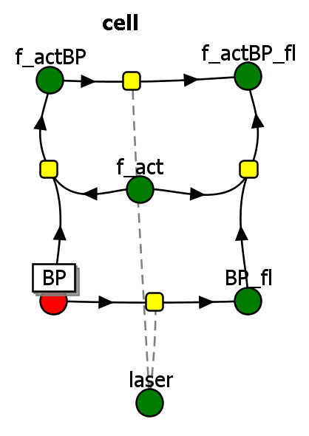
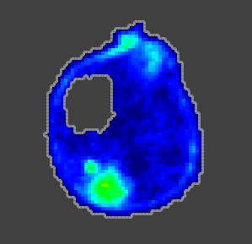
VCell Model of Experiment
Physiology
3D confocal images for geometry
3D confocal images for distribution of f-actin
(Field Data)

Slide 25
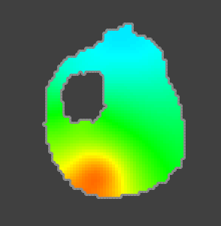
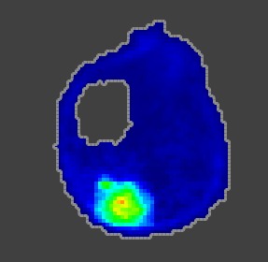
Compare Simulation to Experiment
Free Filamin concentration
Bound Filamin concentration
Single Slice

Slide 26
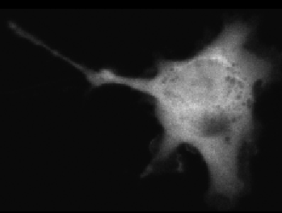
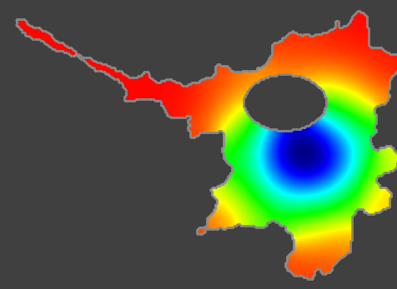
Cannot go from intensity to concentration
ill-posed
well-posed
intensity
concentration
But can go from concentration to intensity

Slide 27
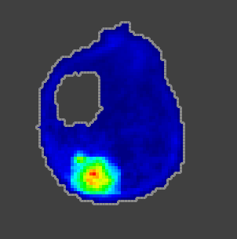
VCell can convolve all fluorescent species
Simulated Fluorescence - convolved

Slide 28
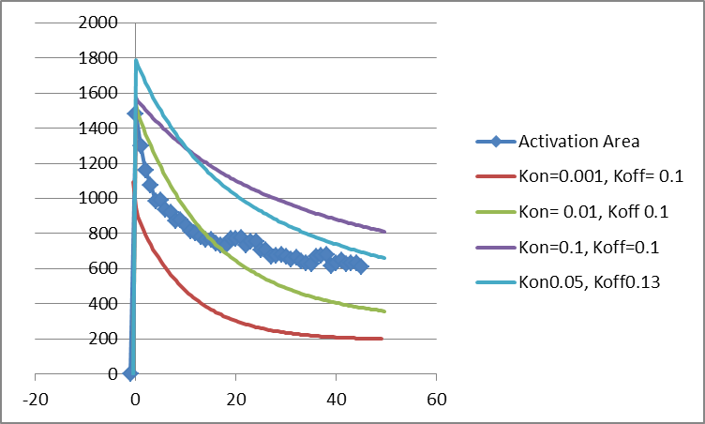
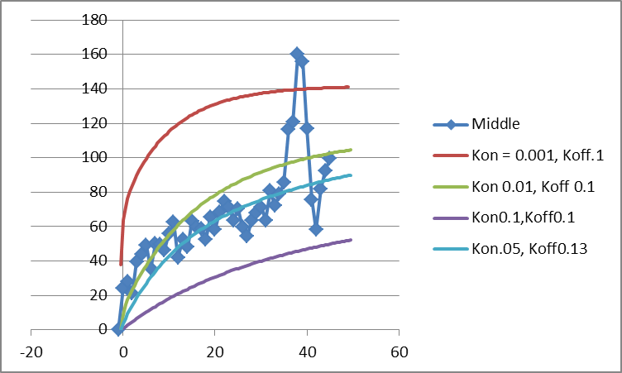
Compare data to sim data for different Koff

Slide 29
Examples of VCell models
Signaling in kidney podocytes

Slide 30
Falkenberg, C. V., E. U. Azeloglu, M. Stothers, T. J. Deerinck, Y. Chen, J. C. He, M. H. Ellisman, J. C. Hone, R. Iyengar, and L. M. Loew.
PLOS Computational Biology 13:e1005433 (2017)
Fragility of foot process morphology in kidney podocytes arises from chaotic spatial propagation of cytoskeletal instability
Supported by NIH Grants P41 GM103313 (NIGMS) and TR01 DK087650 (NIDDK)

Slide 31
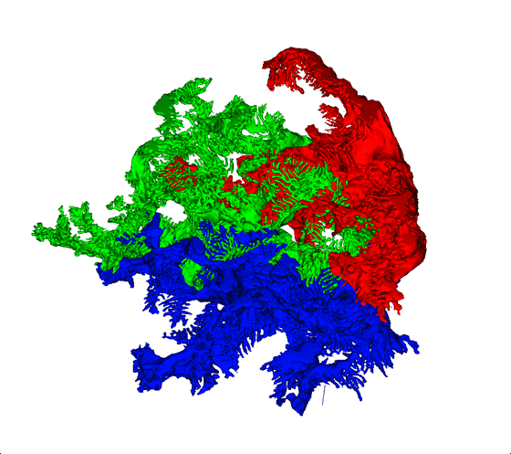
EM reconstruction of kidney podocytes

Slide 32
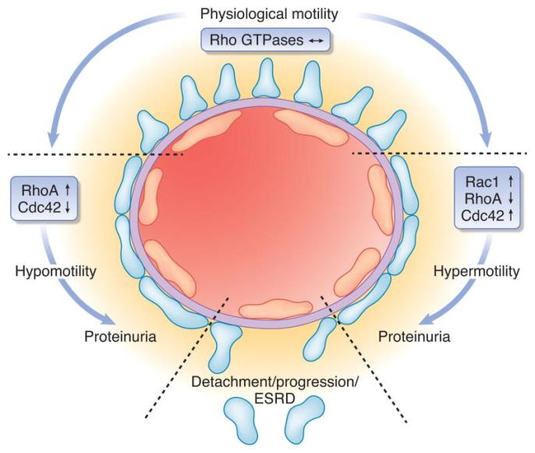
“Both, too much and too little RhoA activity causes podocyte foot process effacement and proteinuria.” Kistler AD, Altintas MM, Reiser J. Kidney Int. 2012 Jun; 8: 1053–1055.
Notes:
ESRD = end-stage renal disease (aka kidney failure). Schematic illustration outlining the tuning of podocyte foot process structure and function by Rho GTPases. Both, too much and too little RhoA activity causes podocyte foot process effacement and proteinuria. The overall dynamic operation of podocyte foot processes is regulated by an interplay of RhoGTPase family members, associated proteins such as RhoA-activated Rac1 GTPase-activating protein (Arhgap24) as well as the large GTPase dynamin. Foot process effacement might be reversible yet failure to restore balance of GTPase signaling will eventually lead to loss of podocytes and progression of glomerular disease.

Slide 33
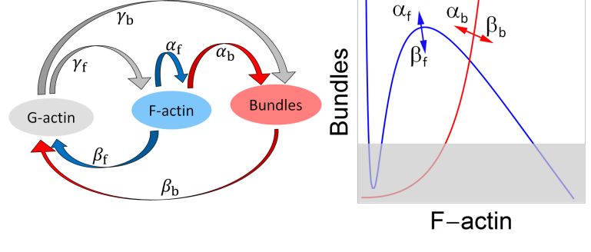
Ga = monmeric G-action
Fa = polymeric F-actin (filaments)
Bu = F-actin bundles (fibers)
Stability of foot processes requires bundles
α_{f} → Rac1 α_{b} → RhoA
Notes:
Minimal kinetic model for actin cytoskeleton in FPs. (A) Reaction diagram and nomenclature for parameters. Each parameter represents the rate of conversion between the two species marked by the arrows. (B) Summary for relationship between nullclines and parameters α_{f}, β_{f}, α_{b} and β_{b}. Blue curves are nullclines for Eq. 1 and red curves for Eq. 2. The arrows represent the direction of change of a given nullcline when the shown parameter increases. The gray shaded region represents the “effacement region” where actin in FPs does not form adequate amount of bundles and maintain a stable FP morphology. (C) A system with strong positive feedback (α_{f}, or weak dissociation rate, β_{f}) has a single stable equilibrium point. The concentrations for bundles and F-actin in the dashed trajectory of the phase plane (left, dashed gray line) are plotted in the time-series to the right, in red and blue, respectively. (D) Weak positive feedback (α_{f}) or strong dissociation rate (β_{f}) give rise to a second stable equilibrium point, representing the collapse of bundles. The concentrations for the solid trajectory in the phase plane (left) are plotted with the solid lines in the time series (right). (E) Weak bundle turnover rate (β_{b}) or strong bundling (α_{b}) destabilizes the system, and there are no longer stable equilibrium points. However, the cyclic behavior might be able to keep the bundles sufficiently strong at all times. (F) A combination of weak bundle turnover rate (β_{b} or strong bundling, α_{b}) and weak positive feedback (α_{f}) results in complete collapse of the actin cytoskeleton. Model parameters listed in Table S1. All concentrations are non-dimensional.

Slide 34
Spatially uniform increase in α_{b}
  Such unpredictable behavior following a change in initial conditions is the hallmark of a chaotic system
Notes:
Impact of hyperactive bundling, α_{b}, on FP actin stability. Spatially, the cyclic behavior (triggered by sudden, but spatially uniform, increase in α_{b} at t = 40) gives rise to asynchronous and progressive loss of actin bundles within FPs (A-D). (A) Spatial steady state actin bundle concentration; simulation parameters are same as those highlighted in Fig 2C. (B) Snapshots of bundle concentration in response to increased bundling, at time t = 1200 and (C) time t = 2400. Insets correspond to magnified and slightly rotated view of respective boxes. The colorbar represents bundle concentration in normalized arbitrary units. (D) Timecourse of bundle concentration at randomly picked FPs, demonstrating asynchronous collapse of bundles. (E) ODE solution for increase in α_{b} predicts cytoskeleton collapse when the actin pool is reduced to 70% of that in Fig 2, (F) For systems with larger pools of actin (115%), stronger yet still unstable bundles are predicted. In spatial simulations the positive feedback, α_{f}, is localized to FPs only, and zero elsewhere.

Slide 35
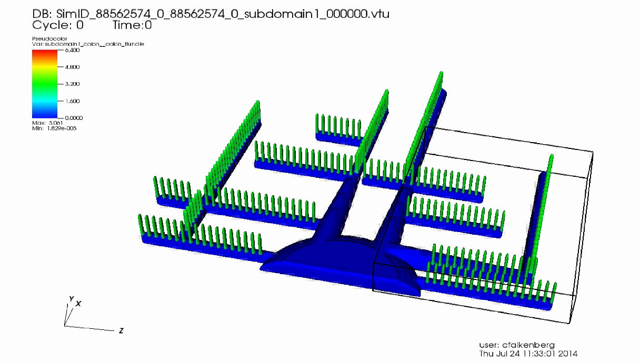

Slide 36
Community Modeling

Slide 37
The Problem: How we build models
Pathway DB
Papers
Rates DB
Identify all molecules (species)
  Initial concentrations
  Transport (Diffusion)
Identify all the reactions (changes in state)
  define a flux reaction and all parameters defining forward and reverse rates (kf and kr).
Define compartment
  Identity, sizes, organization.
Mathematical model
Assemble reactions & species
Select rate law for each reaction
Simulators
Combine rate laws into
sets of equations
Validation
Validation
Calibrate parameters
against data
Validate model with new data

Slide 38
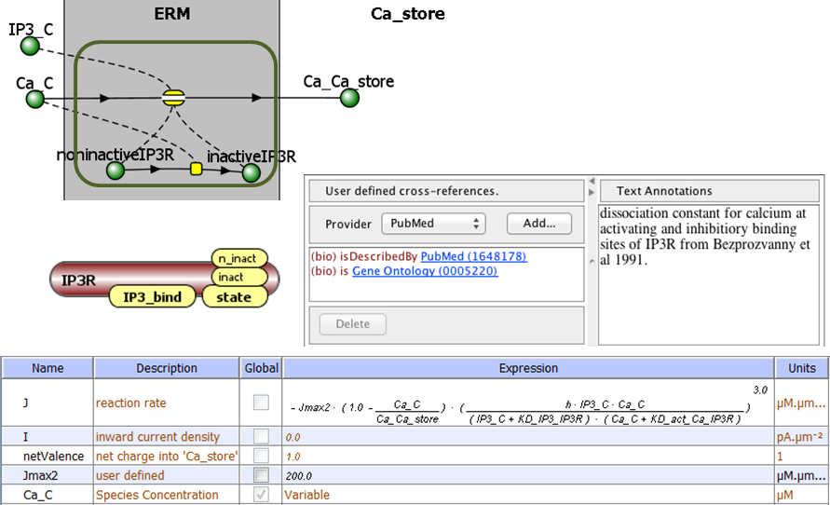
Wouldn’t it be great if….
All this information could be kept stored together, so it doesn’t get lost

Slide 39
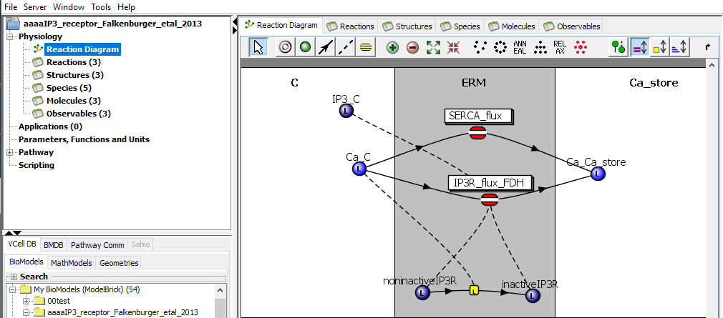
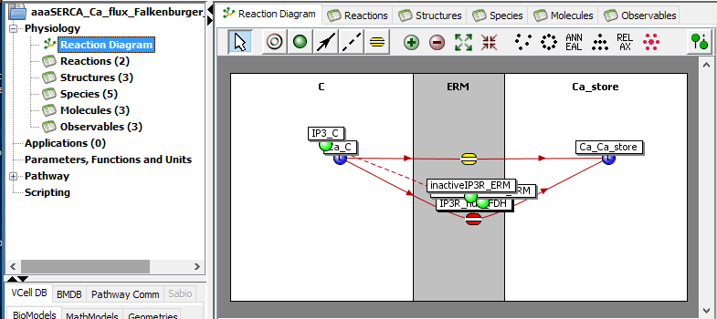
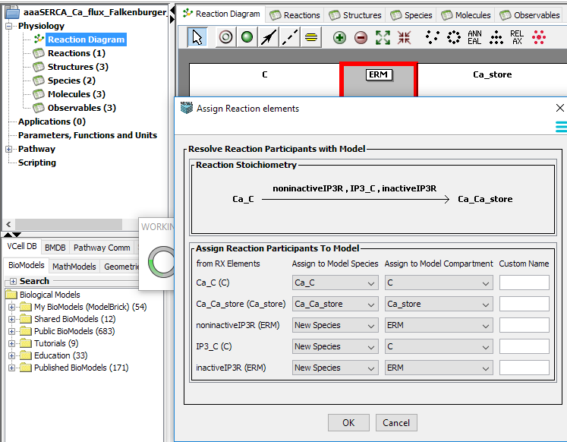
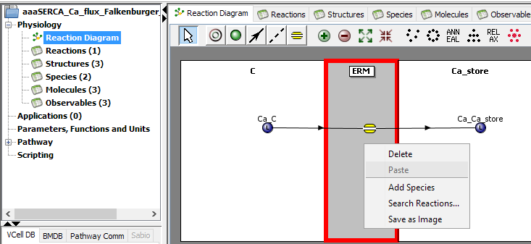
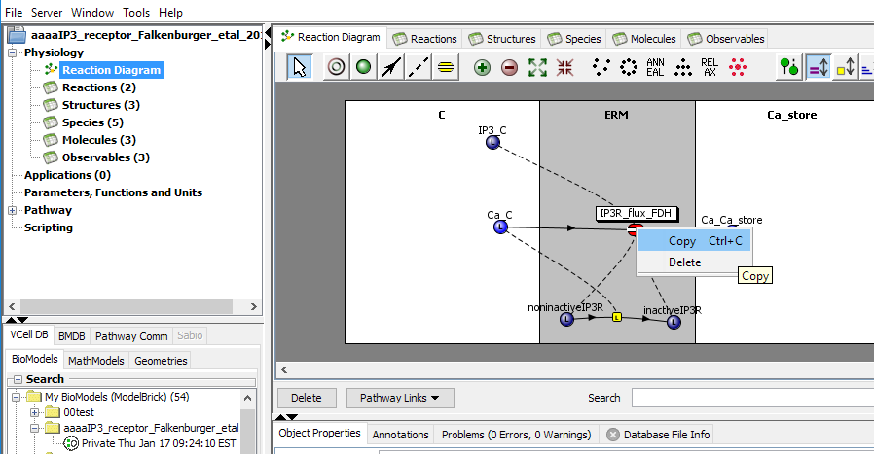
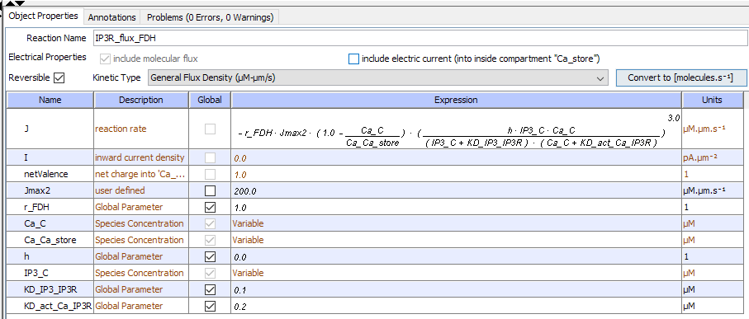
“Smart” copy and paste in VCell

Slide 40
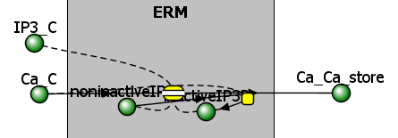
Wouldn’t it be great if….
All this information could be kept stored together, so it doesn’t get lost
IP3R Ca Flux
ModelBrick

Slide 41

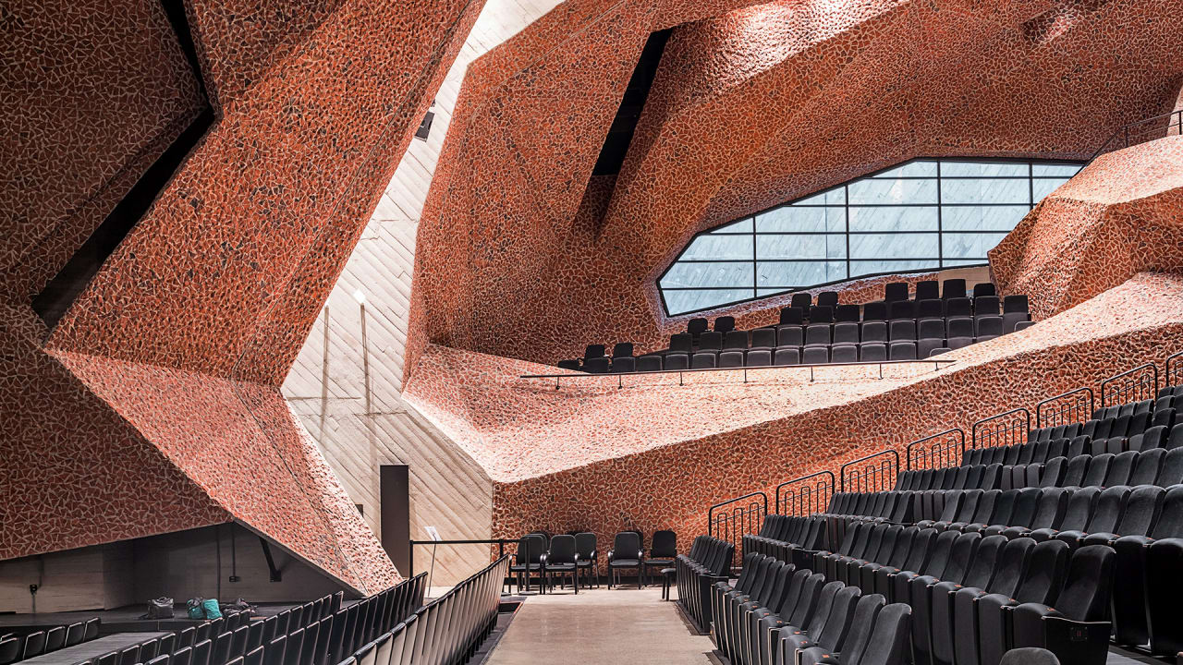
ModelBricks: Building reusable models from a repository of well annotated model components
Notes:
CKK Jordanki concert hall in Poland

Slide 42


ModelBricks: Building reusable models from a repository of well annotated model components

Slide 43

vcell.org Web Resources
Downloads: http://vcell.org/run-vcell-software
VCell Support: vcell_support@uchc.edu
Google Discussion Forum: https://groups.google.com/forum/#!forum/vcell-discuss
Tutorials and help: http://vcell.org/support
YouTube Channel https://www.youtube.com/user/VCellEducation
Published VCell models: http://vcell.org/vcell-published-models
SpringSaLaD: http://vcell.org/ssalad

