Slide 1
http://CompModelMatch.org
David Stone ¹ & Michael Blinov ²
¹ University of Illinois at Chicago
² University of Connecticut School of Medicine
Find Your Inner Modeler III, June 14, 2019

Slide 2
NIH, NSF:
COLLABORATE!!!!

Slide 3

How researchers find each other?
Recent talks
Recent posters
Lab website
PubMed
BioRxiv
ORCID
Research Gate
…

Slide 4
How researchers find each other?
Recent talks
Recent posters
Lab website
PubMed
BioRxiv
ORCID
Research Gate
…
What to do if researchers
attend different meetings?
Often outdated and
does not represent
current interests

Slide 5
Solution: “science dating”
Only interested scientists meet
Only projects of interest are displayed
The goal of dating is clearly stated
  Need experimental data
  Need data analysis
  Need modeling analysis
  Need grant
  Need certain advise on expertise
  …

Slide 6
Requirements
A place to display researchers skills
A place to display projects with goals
A place to assemble papers and documents related to this project/goal
An expiration date for each project, so they do not hang forever
A way to track progress of project of interest (subscription).
A way to request access to more data (project membership).

Slide 7
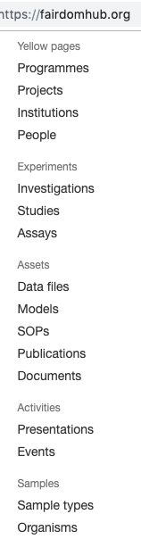


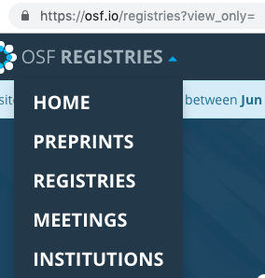
Project management systems

Slide 8
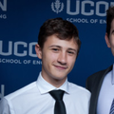
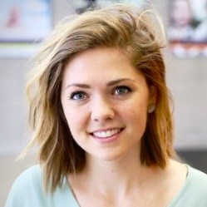

Team
CODING:
Daniel Fryer,
CS major, UConn
DESIGN:
Dani Bergey,
BioMedical Visualization, UIC
Pilot funding:

